Slide 1
Security camera
Prototype

Slide 2
Theory
Product backlog/spring backlog
https://trello.com/b/v4QAUZTq/camera-project

Slide 3

Diagrams
Sequence diagram for system
Class diagram of system
State chart for the receiver

Slide 4
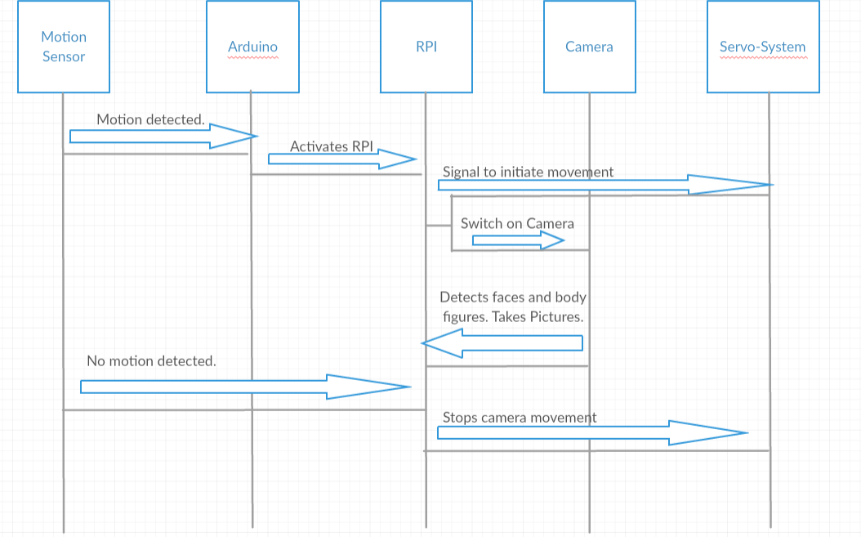

Slide 5
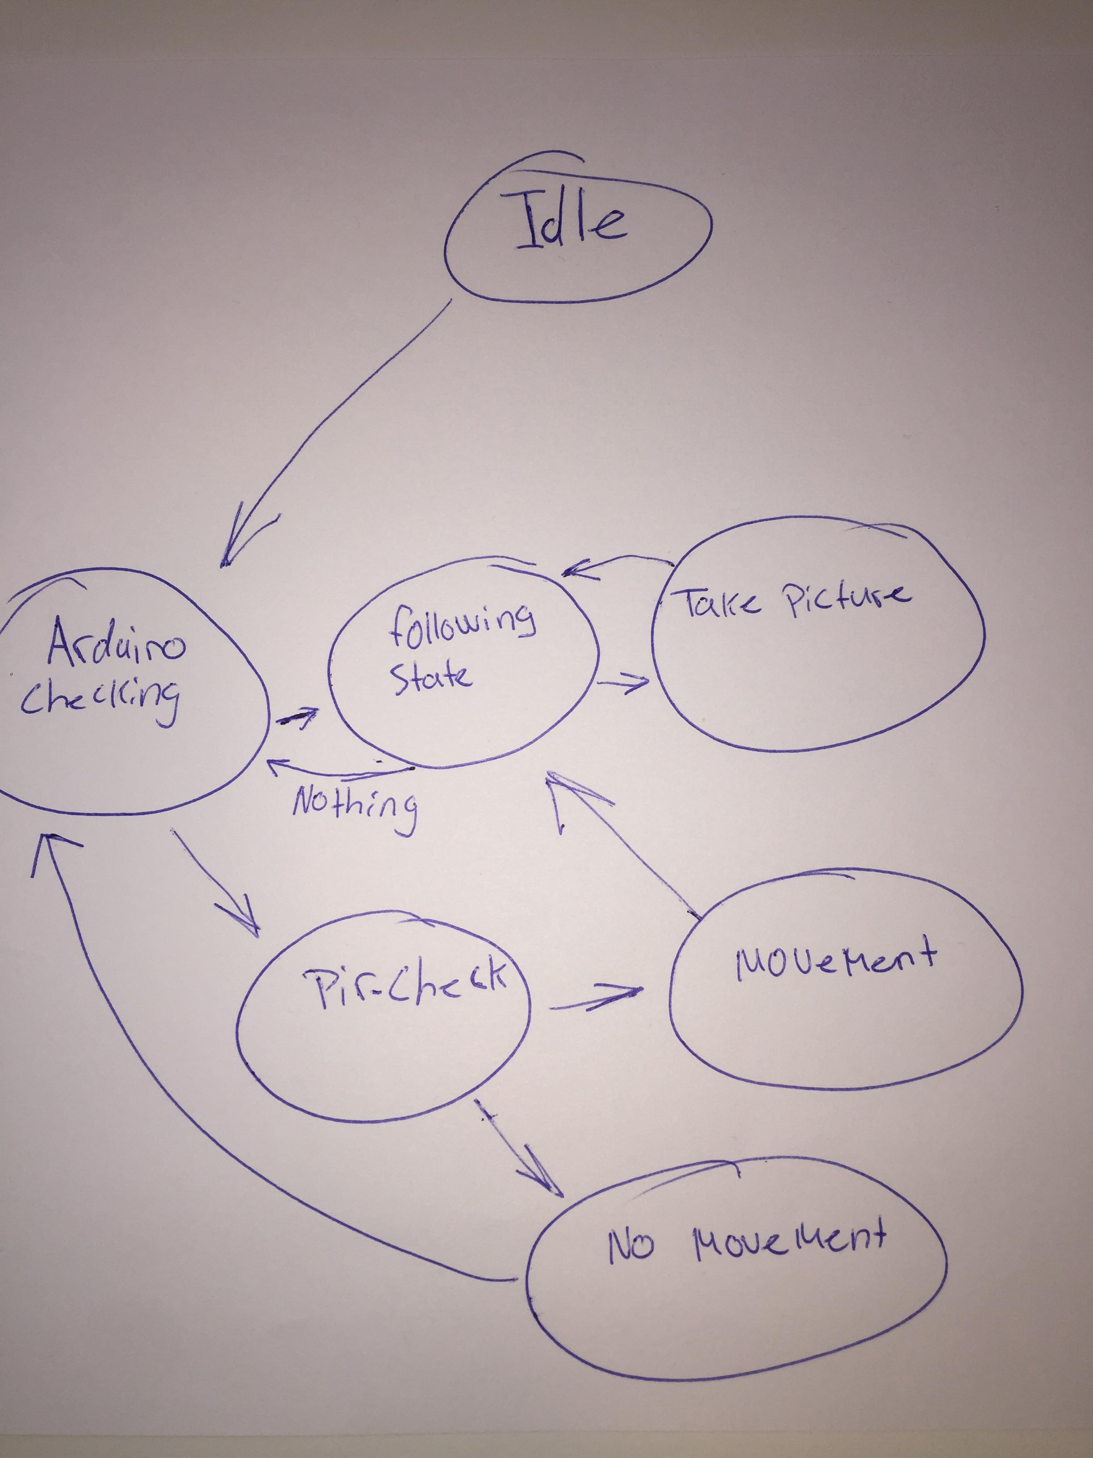

Slide 6


Demo

Slide 7

questions

